Slide 1
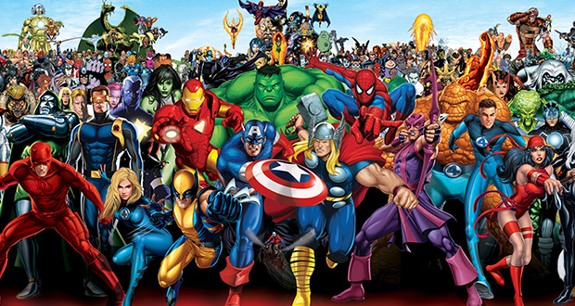
Superhero Study Skills
Credit: Alexis Thompson
Notes:
Each superhero (except Batman) has a YouTube video linked when you click the hero. Connections to study skills are listed in each slide. Allow students to make their own connections as well.

Slide 2
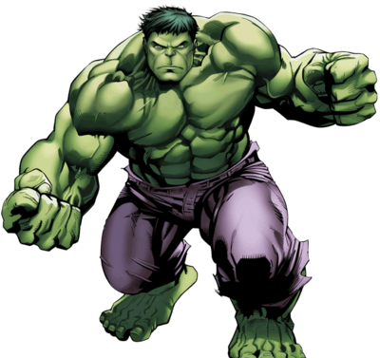
Notes:
Focus during class – self-restraint, making good decisions
Just like how Bruce Banner stops himself from turning into the Hulk

Slide 3
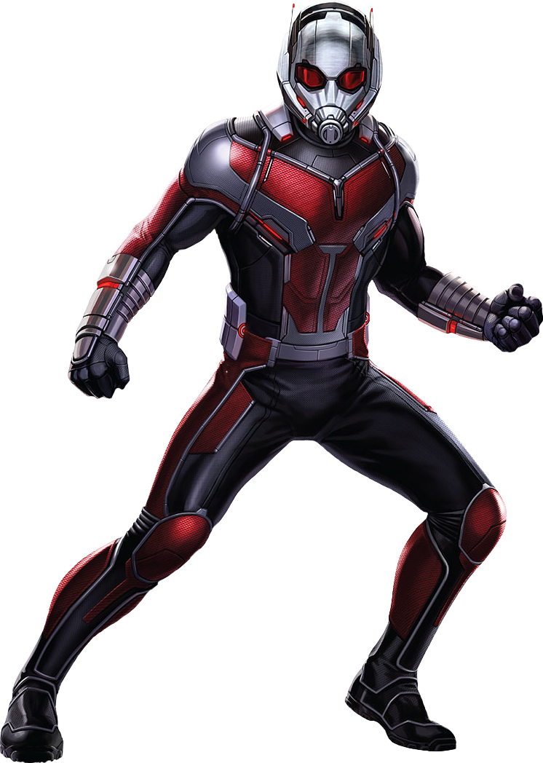
Notes:
Use abbreviations (shortened versions of words) to write notes faster

Slide 4
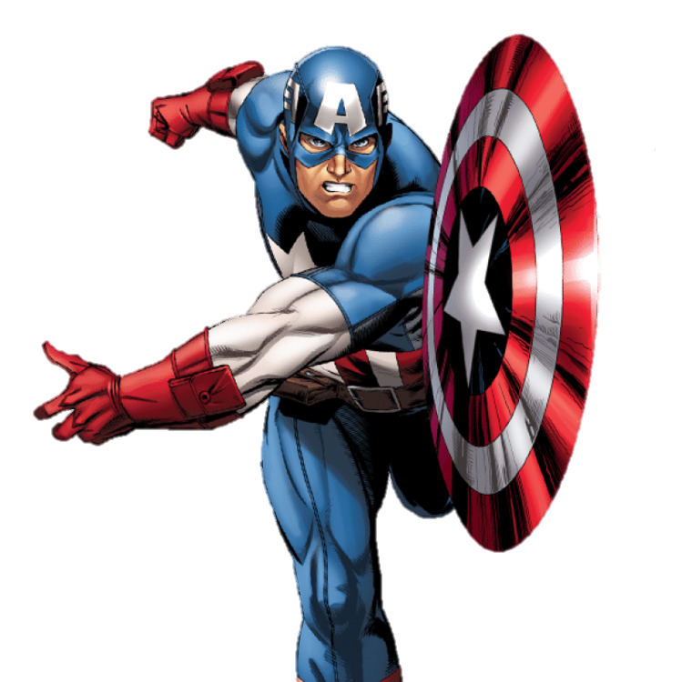
Notes:
Practice makes perfect! Study a little every day and always do your homework
Just like how Steve Rogers practiced every day to get strong enough to join the military

Slide 5
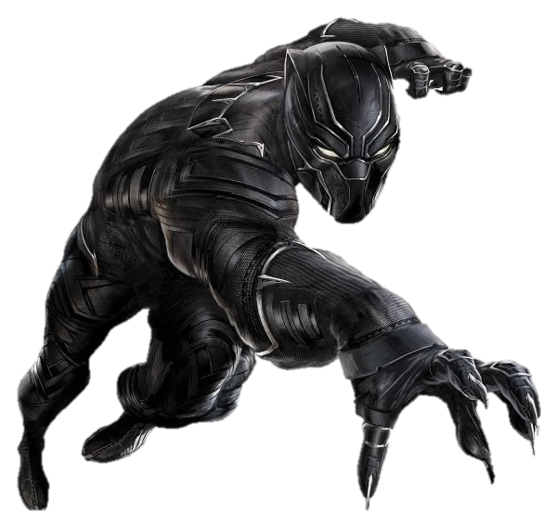
Notes:
Set aside a time and a place to study – make it remote like Wakanda, no distractions. How else do you think they got so smart?

Slide 6
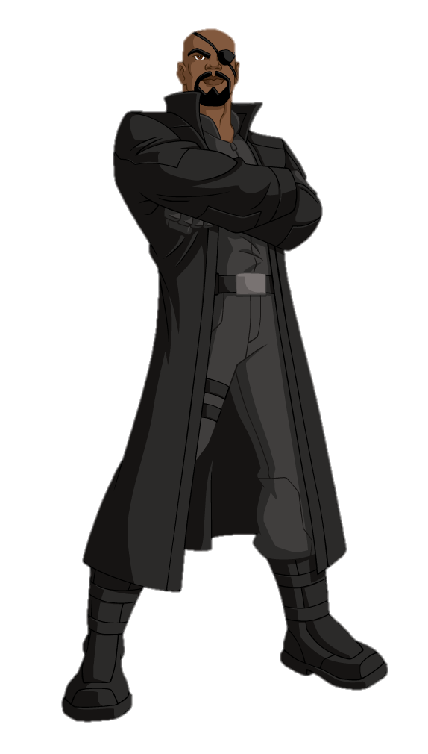
Notes:
Ask for help! If you don’t understand something while studying, circle it and ask the teacher about it the next day
Just like when Nick Fury assembles the Avengers when he needs help (or like he did at the end of Infinity Wars)

Slide 7
Notes:
Encourage others, but don’t let them distract you! Know yourself – if group studying helps, try it, but make sure you’re all focused on making each other the best they can be.

Slide 8
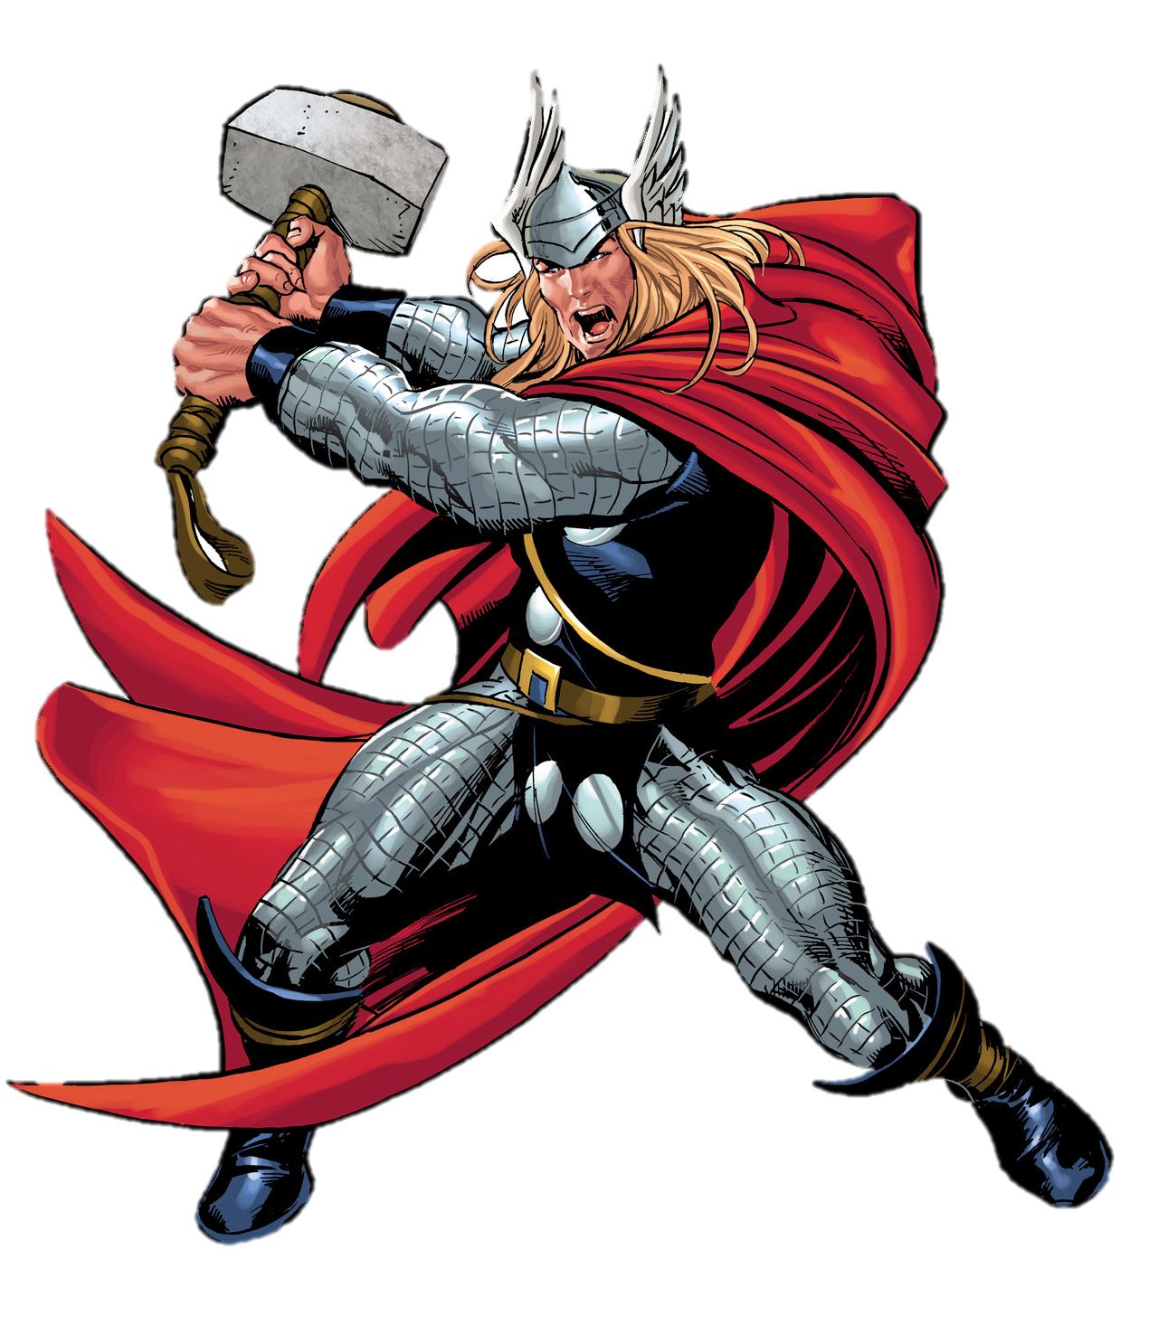
Notes:
Make a schedule so you can balance your time between studying and relaxing.
(like how Thor balanced his time between Earth and Asgard in the first two Thor movies)

Slide 9
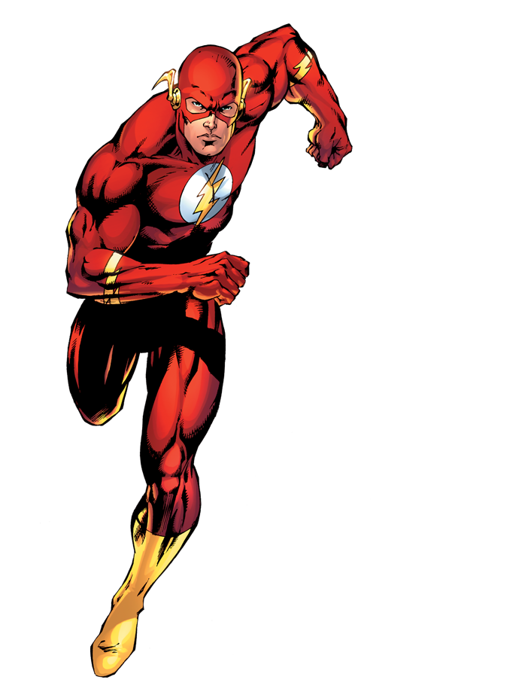
Notes:
Use flashcards! If you have a computer, look them up online – it saves time.

Slide 10
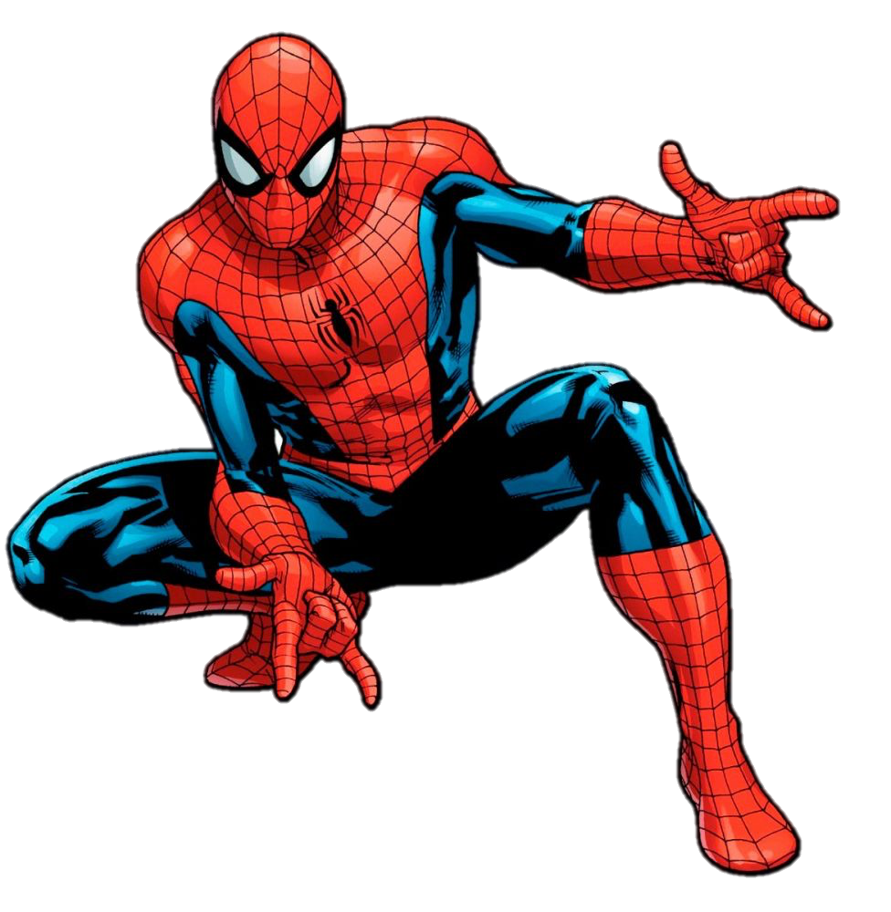
Notes:
Go ‘on the web’ for practice quizzes, worksheets, and flashcards (like we mentioned)

Slide 11
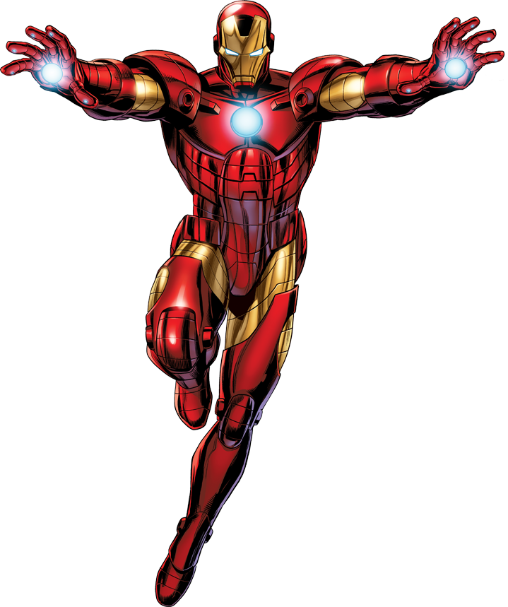
Notes:
After you’ve done your studying, teach someone else what you know! Just like how Iron Man teaches Spider-Man how to be an Avenger.

Slide 12
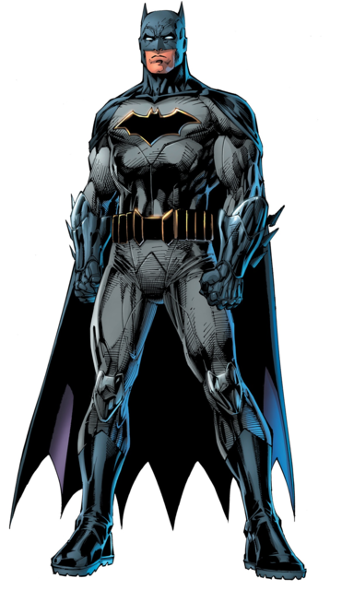
Notes:
Review your notes the night before but get a good night’s sleep the night before the test (that’s what Alfred would want for Batman)

Slide 13
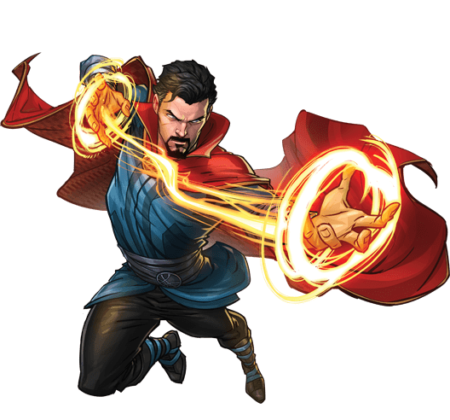
Notes:
While taking the test, conquer test anxiety by visualizing a happy place (just like Dr. Strange does with the sling ring to open portals to other places)

